Slide 1
Chapter 8
How to use arrays and collections

Slide 2
Objectives (part 1)
Applied
Given the specifications for an application that requires the use of a one-dimensional, rectangular, or jagged array, write the code that works with the array.
Given the specifications for an application that requires the use of one of the collection classes presented in this chapter, write the code that works with the collection.
Knowledge
Distinguish between a for loop and a foreach loop.
Explain how the Array class can be used with an array.
Describe how the null-conditional operator works and when you would use it.

Slide 3
Objectives (part 2)
Distinguish between an untyped and a typed collection class.
Describe the differences between these collection classes: list, sorted list, queue, stack, and array list.

Slide 4
The syntax for creating a one-dimensional array
With two statements
type[] arrayName; // declaration statement
arrayName = new type[arrayLength]; // assignment statement
With one statement
type[] arrayName = new type[arrayLength];
Examples that create an array of decimal types
With two statements
decimal[] totals;
totals = new decimal[4];
With one statement
decimal[] totals = new decimal[4];

Slide 5
An array of strings
string[] description = new string[3];
Two arrays in one statement
const int MaxCount = 100;
decimal[] prices = new decimal[MaxCount],
discountPercentages = new decimal[MaxCount];

Slide 6
Default values for array elements
Data type Default value
numeric 0 (zero)
char '\0' (the null character)
Boolean false
DateTime 01/01/0001 00:00:00
reference types null

Slide 7
The syntax for referring to an element of an array
arrayName[index]
Assign values by accessing each element
Code that assigns values to an array of decimal types
decimal[] totals = new decimal[4];
totals[0] = 14.95m;
totals[1] = 12.95m;
totals[2] = 11.95m;
totals[3] = 9.95m;
//totals[4] = 8.95m; // would throw an IndexOutOfRangeException
Code that assigns objects to an array of strings
string[] names = new string[3];
names[0] = "Ted Lewis";
names[1] = "Sue Jones";
names[2] = "Ray Thomas";

Slide 8
The syntax for creating an array and assigning values in one statement
type[] arrayName = [new type[length]] {value1[, value2][, value3]...};
Examples
decimal[] totals =
new decimal[4] {14.95m, 12.95m, 11.95m, 9.95m};
decimal[] totals = {14.95m, 12.95m, 11.95m, 9.95m};
string[] names =
{"Ted Lewis", "Sue Jones", "Ray Thomas"};
Infer the type of an array from its values
var grades = new[] {95, 89, 91, 98};

Slide 9
The syntax for using the Length property
arrayName.Length
Code that computes the average of an array of totals
decimal[] totals = {14.95m, 12.95m, 11.95m, 9.95m};
decimal sum =
totals[0] + totals[1] + totals[2] + totals[3];
decimal average = sum/4;
Code that puts the numbers 0 through 9 into an array
int[] numbers = new int[10];
for (int i = 0; i < numbers.Length; i++)
numbers[i] = i;

Slide 10
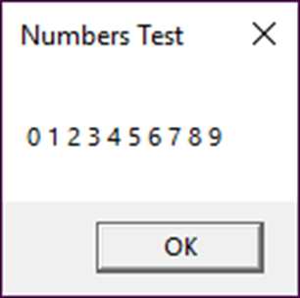
Code that displays the numbers array
string numbersString = "";
for (int i = 0; i < numbers.Length; i++)
numbersString += numbers[i] + " ";
MessageBox.Show(numbersString, "Numbers Test");

Slide 11
A for loop to compute the average of the totals array
decimal sum = 0.0m;
for (int i = 0; i < totals.Length; i++)
sum += totals[i];
decimal average = sum/totals.Length;

Slide 12
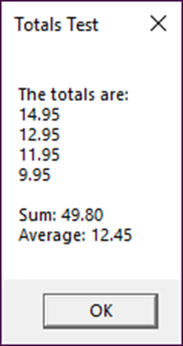
Code that uses a for statement to display the totals array
string totalsString = "";
for (int i = 0; i < totals.Length; i++)
totalsString += totals[i] + "\n";
MessageBox.Show("The totals are:\n" +
totalsString + "\n" +
"Sum: " + sum + "\n" +
"Average: " + average, "Totals Test");

Slide 13
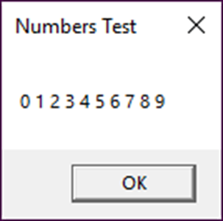
The syntax of a foreach loop
foreach (type elementName in arrayName)
{
statements
}
Code that displays the numbers array
string numbersString = "";
foreach (int number in numbers)
{
numbersString += number + " ";
}
MessageBox.Show(numbersString, "Numbers Test");

Slide 14
Code that computes the average of the totals array
decimal sum = 0.0m;
foreach (decimal total in totals)
sum += total;
decimal average = sum/totals.Length;

Slide 15
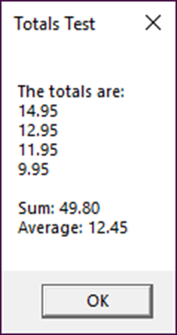
Code that uses a foreach statement to display the totals array
string totalsString = "";
foreach (decimal total in totals)
totalsString += total + "\n";
MessageBox.Show("The totals are:\n" +
totalsString + "\n" +
"Sum: " + sum + "\n" +
"Average: " + average,
"Totals Test");

Slide 16
The syntax for creating a rectangular array
type[,] arrayName = new type[rowCount,columnCount];
A statement that creates a 3x2 array
int[,] numbers = new int[3,2];

Slide 17
The syntax for referring to an element of a rectangular array
arrayName[rowIndex, columnIndex]
The index values for the elements of a 4x4 rectangular array
0,0 0,1 0,2 0,3
1,0 1,1 1,2 1,3
2,0 2,1 2,2 2,3
3,0 3,1 3,2 3,3
Code that assigns values to the numbers array
numbers[0,0] = 1;
numbers[0,1] = 2;
numbers[1,0] = 3;
numbers[1,1] = 4;
numbers[2,0] = 5;
numbers[2,1] = 6;

Slide 18
Code that creates a 3x2 array and assigns values with one statement
int[,] numbers = { {1,2}, {3,4}, {5,6} };
Code that creates and assigns values to a 3x2 array of strings
string[,] products =
{{"C#", "Murach's C#"},
{"JAVA", "Murach's Java Programming"},
{"ASPMVC", "Murach's ASP.NET MVC"}};
Another way to create the array of strings
var products = new[,]
{{"C#", "Murach's C#"},
{"JAVA", "Murach's Java Programming"},
{"ASPMVC", "Murach's ASP.NET MVC"}};

Slide 19
The syntax for using the GetLength() method
arrayName.GetLength(dimensionIndex)
Code that works with the numbers array
int numberOfRows = numbers.GetLength(0);
int numberOfColumns = numbers.GetLength(1);
int sumOfFirstRow = numbers[0,0] + numbers[0,1];
Description
You use the GetLength() method to get the number of rows or columns in a rectangular array. To get the number of rows, specify 0 for the dimensionIndex argument. To get the number of columns, specify 1 for this argument.

Slide 20
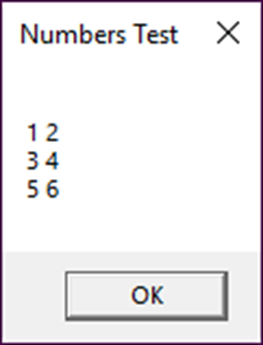
Code that displays the rectangular numbers array
string numbersString = "";
for (int i = 0; i < numbers.GetLength(0); i++)
{
for (int j = 0; j < numbers.GetLength(1); j++)
numbersString += numbers[i,j] + " ";
numbersString += "\n";
}
MessageBox.Show(numbersString, "Numbers Test");

Slide 21
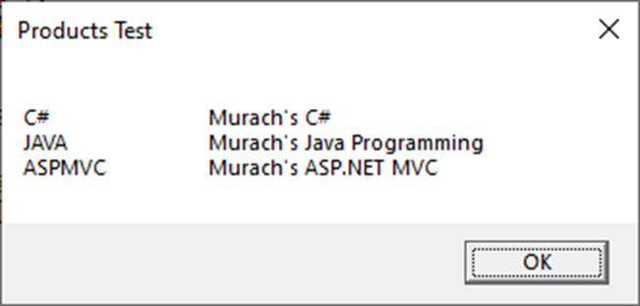
Code that displays the products array
string productsString = "";
for (int i = 0; i < products.GetLength(0); i++)
{
for (int j = 0; j < products.GetLength(1); j++)
productsString += products[i,j] + "\t\t";
productsString += "\n";
}
MessageBox.Show(productsString, "Products Test");

Slide 22
The syntax for creating a jagged array
type[][] arrayName = new type[rowCount][];
Code that creates a jagged array with three rows of different lengths
int[][] numbers = new int[3][]; // the number of rows
numbers[0] = new int[3]; // the number of columns for row 1
numbers[1] = new int[4]; // the number of columns for row 2
numbers[2] = new int[2]; // the number of columns for row 3

Slide 23
The syntax for referring to an element of a jagged array
arrayName[rowIndex][columnIndex]
Code that assigns values to the numbers array
numbers[0][0] = 1; numbers[1][0] = 4; numbers[2][0] = 8;
numbers[0][1] = 2; numbers[1][1] = 5; numbers[2][1] = 9;
numbers[0][2] = 3; numbers[1][2] = 6;
numbers[1][3] = 7;
Code that creates the numbers array with one statement
int[][] numbers = { new int [] {1, 2, 3},
new int [] {4, 5, 6, 7},
new int [] {8, 9} };

Slide 24
Code that creates a jagged array of strings
string[][] titles = {
new string [3] {"War and Peace", "Wuthering Heights", "1984"},
new string [4] {"Casablanca", "Wizard of Oz", "Star Wars", "Birdy"},
new string [2] {"Blue Suede Shoes", "Yellow Submarine"} };
Another way to create a jagged array of strings
var titles = new[]
{(new[] {"War and Peace", "Wuthering Heights", "1984"}), (new[] {"Casablanca", "Wizard of Oz", "Star Wars", "Birdy"}), (new[] {"Blue Suede Shoes", "Yellow Submarine"})};

Slide 25
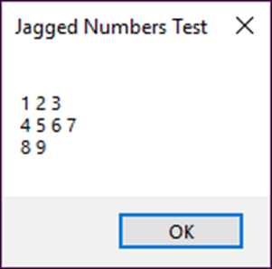
Code that displays the jagged numbers array
string numbersString = "";
for (int i = 0; i < numbers.GetLength(0); i++)
{
for (int j = 0; j < numbers[i].Length; j++)
numbersString += numbers[i][j] + " ";
numbersString += "\n";
}
MessageBox.Show(numbersString, "Jagged Numbers Test");

Slide 26
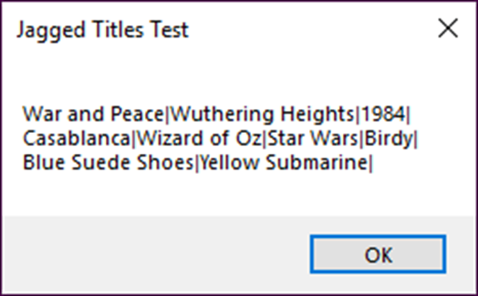
Code that displays the titles array
string titlesString = "";
for (int i = 0; i < titles.GetLength(0); i++)
{
for (int j = 0; j < titles[i].Length; j++)
titlesString += titles[i][j] + "|";
titlesString += "\n";
}
MessageBox.Show(titlesString, "Jagged Titles Test");

Slide 27
Common properties and methods of the Array class (part 1)

Slide 28
Common property of the Array class
Property Description
Length Gets the number of elements in all of the dimensions of an array.
Common instance methods of the Array class
Instance method Description
GetLength(dimension) Gets the number of elements in the specified dimension of an array.
GetUpperBound(dimension) Gets the index of the last element in the specified dimension of an array.

Slide 29
Common static methods of the Array class
Static method Description
Copy(array1, array2, length) Copies some or all of the values in one array to another array.
BinarySearch(array, value) Searches a one-dimensional array that’s in ascending order for an element with a specified value and returns the index for that element.
Sort(array) Sorts the elements in a one-dimensional array into ascending order.

Slide 30
Code that uses the GetLength() and GetUpperBound() methods
int[] numbers = new int[4] {1, 2, 3, 4};
int length = numbers.GetLength(0); // length = 4
int upperBound = numbers.GetUpperBound(0); // upperBound = 3

Slide 31
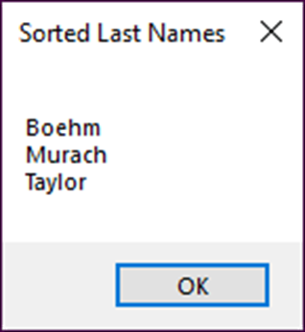
Code that uses the Sort() method
string[] lastNames = {"Boehm", "Taylor", "Murach"};
Array.Sort(lastNames);
string message = "";
foreach (string lastName in lastNames)
message += lastName + "\n";
MessageBox.Show(message, "Sorted Last Names");

Slide 32
Code that uses the BinarySearch() method
string[] employees =
{"AdamsA", "FinkleP", "LewisJ", "PotterE"};
decimal[] salesAmounts =
{3275.68m, 4298.55m, 5289.57m, 1933.98m};
int index = Array.BinarySearch(employees, "FinkleP");
decimal salesAmount = salesAmounts[index];
// salesAmount = 4298.55

Slide 33
Code that creates a reference to another array
double[] inches1 = new double[3] {1,2,3};
double[] inches2 = inches1;
inches2[2] = 4; // changes the third element
Code that reuses an array variable
inches1 = new double[20]; // make a new array with 20 elements

Slide 34
The syntax for copying elements of an array
Array.Copy(fromArray, toArray, length);
Code that copies all the elements of an array
double[] inches = new double[3] {1,2,3};
double[] centimeters = new double[3];
Array.Copy(inches, centimeters, inches.Length);
for (int i = 0; i < centimeters.Length; i++)
centimeters[i] *= 2.54; // set the new values

Slide 35
Another way to copy elements from one array to another
Array.Copy(fromArray, fromIndex,
toArray, toIndex, length);
Code that copies some of the elements of an array
string[] names = {"Martinez", "Murach", "Boehm"};
string[] lastTwoNames = new string[2];
Array.Copy(names, 1, lastTwoNames, 0, 2);

Slide 36
The code for a method that returns an array
private decimal[] GetRateArray(int elementCount)
{
decimal[] rates = new decimal[elementCount];
for (int i = 0; i < rates.Length; i++)
rates[i] = (decimal) (i + 1) / 100;
return rates;
}
A statement that calls the method
decimal[] rates = this.GetRateArray(4);

Slide 37
A method that accepts an array argument
private void ToCentimeters(double[] measurements)
{
for (int i = 0; i < measurements.Length; i++)
measurements[i] *= 2.54;
}
Statements that declare the array and call the method
double[] measurements = {1,2,3};
this.ToCentimeters(measurements);

Slide 38
A method that uses the params keyword
private double[] ToCentimeters(
params double[] measurements)
{
for (int i = 0; i < measurements.Length; i++)
measurements[i] *= 2.54;
return measurements;
}
A statement that calls the method
double[] measurements = this.ToCentimeters(1,2,3);

Slide 39
A statement that creates a null array
string[] initials = null;
A statement that will throw a NullReferenceException
string firstInitial = initials[0].ToUpper();

Slide 40
Code that uses if statements to prevent a NullReferenceException
if (initials != null)
{
if (initials[0] != null)
{
string firstInitial = initials[0].ToUpper();
}
}
A statement that uses null-conditional operators to prevent a NullReferenceException
string firstInitial = initials?[0]?.ToUpper();
A statement that uses a nullable type
int? length = initials?.Length;

Slide 41
The array that’s used in the following examples
decimal[] sales =
{ 22125.67m, 25362.35m, 21478.93m, 27495.72m,
26405.61m, 19476.29m, 31837.56m, 28649.01m };
How to refer to an element from the end of an array
decimal previousMonthSales = sales[^2]; // 31837.56

Slide 42
How to refer to a range of elements
By including starting and ending indexes
var firstQtrSales = sales[0..3]; // indexes 0 through 2
By including just an ending index
var firstQtrSales = sales[..3]; // indexes 0 through 2
By including just a starting index
var secondHalfSales = sales[6..]; // indexes 6 through 7
By including no starting or ending index
var YTDSales = sales[..]; // indexes 0 through 7
By including an index from the end of the array
var secondQtrSales = sales[3..^2]; // indexes 3 through 5

Slide 43
How to use a range in a foreach loop
totalSales = 0.0m;
foreach (decimal sale in sales[3..6]) // indexes 3 through 5
{
totalSales += sale;
}

Slide 44
How to use the Index and Range types (.NET Core 3.0 and later only)
Index previousMonthIndex = ^2;
Decimal previousMonthSales = sales[previousMonthIndex];
// 31837.56
Range secondQtrRange = 3..6;
var secondQtrSales = sales[secondQtrRange];
// indexes 3 through 5

Slide 45
How arrays and collections are similar
Both can store multiple elements, which can be value types or reference types.
How arrays and collections are different
An array is a feature of the C# language. Collections are .NET classes.
Collection classes provide methods to perform operations that arrays don’t provide.
Arrays are fixed in size. Collections are variable in size.

Slide 46
Commonly used collection classes (part 1)
Typed Untyped Description
List<T> ArrayList Uses an index to access each element. Is very efficient for accessing elements sequentially. Can be inefficient when inserting elements into the middle of a list.
SortedList<K, V> SortedList Uses a key to access a value, which can be any type of object.Can be inefficient for accessing elements sequentially.Is very efficient for inserting elements into the middle of a list.

Slide 47
Commonly used collection classes (part 2)
Queue<T> Queue Uses methods to add and remove elements.
Stack<T> Stack Uses methods to add and remove elements.

Slide 48
The using directive for untyped collections
using System.Collections;
Code that uses an untyped collection
ArrayList numbers = new ArrayList();
numbers.Add(3);
numbers.Add(7);
numbers.Add("Test"); // will compile - causes runtime error
int sum = 0;
for (int i = 0; i < numbers.Count; i++)
{
int number = (int)numbers[i]; // cast is required
sum += number;
}

Slide 49
The using directive for typed collections
using System.Collections.Generic;
Code that uses a typed collection
List<int> numbers = new List<int>();
numbers.Add(3);
numbers.Add(7);
//numbers.Add("Test"); // won't compile - prevents runtime error
int sum = 0;
for (int i = 0; i < numbers.Count; i++)
{
int number = numbers[i]; // no cast needed
sum += number;
}

Slide 50
A list of string elements
List<string> titles = new List<string>();
A list of decimal elements
List<decimal> prices = new List<decimal>();
A list of strings with a capacity of 3
List<string> lastNames = new List<string>(3);

Slide 51
Common properties and methods of the List<> class (part 1)
Indexer Description
[index] Gets or sets the element at the specified index. The index for the first item in a list is 0.
Property Description
Capacity Gets or sets the number of elements a list can hold.
Count Gets the number of elements in a list.
Method Description
Add(object) Adds an element to the end of a list and returns the element’s index.
Clear() Removes all elements from a list and sets its Count property to zero.

Slide 52
Common properties and methods of the List<> class (part 2)
Contains(object) Returns a Boolean value that indicates if a list contains the specified object.
Insert(index, object) Inserts an element into a list at the specified index.
Remove(object) Removes the first occurrence of the specified object from a list.
RemoveAt(index) Removes the element at the specified index of a list.
BinarySearch(object) Searches a list for a specified object and returns the index for that object.
Sort() Sorts the elements in a list into ascending order.

Slide 53
Code that causes the size of a list of names to be increased
List<string> lastNames = new List<string>(3);
lastNames.Add("Boehm");
lastNames.Add("Martinez");
lastNames.Add("Murach");
lastNames.Add("Taylor"); // Capacity is doubled to 6 elements
lastNames.Add("Spera");
lastNames.Add("Steelman");
lastNames.Add("Slivkoff"); // Capacity is doubled to 12 elements

Slide 54
The syntax for retrieving a value from a list
listName[index]
Code that creates a list that holds decimal values
List<decimal> salesTotals = new List<decimal>
{ 3275.68m, 4398.55m, 5289.75m, 1933.98m };
Code that retrieves the first value from the list
decimal sales1 = salesTotals[0]; // sales1 = 3275.68

Slide 55
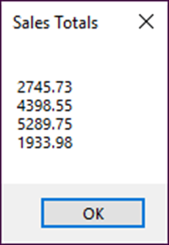
Code that inserts and removes an element from the list
salesTotals.Insert(0, 2745.73m); // insert a new first element
sales1 = salesTotals[0]; // sales1 = 2745.73
decimal sales2 = salesTotals[1]; // sales2 = 3275.68
salesTotals.RemoveAt(1); // remove the second element
sales2 = salesTotals[1]; // sales2 = 4398.55
Code that displays the list in a message box
string salesTotalsString = "";
foreach (decimal d in salesTotals)
salesTotalsString += d.ToString() + "\n";
MessageBox.Show(salesTotalsString, "Sales Totals");

Slide 56
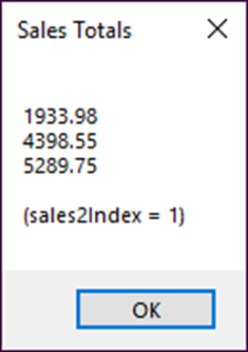
Code that checks for an element in the list and removes it if it exists
decimal x = 2745.73m;
if (salesTotals.Contains(x))
salesTotals.Remove(x);
Code that sorts and searches the list
salesTotals.Sort();
int sales2Index = salesTotals.BinarySearch(sales2);
A message box that displays the results

Slide 57
Common properties of the SortedList<> class
Indexer Description
[key] Gets or sets the value of the element with the specified key.
Property Description
Keys Gets a collection that contains the keys in the list.
Values Gets a collection that contains the values in the list.
Capacity Gets or sets the number of elements the list can hold.
Count Gets the number of elements in the list.

Slide 58
Common methods of the SortedList<> class
Method Description
Add(key, value) Adds an element with the specified key and value to the sorted list.
Clear() Removes all elements from the sorted list.
ContainsKey(key) Returns a Boolean value that indicates whether or not the sorted list contains the specified key.
ContainsValue(value) Returns a Boolean value that indicates whether or not the sorted list contains the specified value.
Remove(key) Removes the element with the specified key from the sorted list.
RemoveAt(index) Removes the element at the specified index from the sorted list.

Slide 59
Properties of the KeyValuePair<K, V> structure
Property Description
Key The key for the SortedList item.
Value The value associated with the key.

Slide 60
How to create and load a sorted list
With separate statements
SortedList<string, decimal> salesList = new SortedList<string, decimal>(4);
salesList.Add("FinkleP", 4398.55m);
salesList.Add("AdamsA", 3275.68m);
salesList.Add("PotterE", 1933.98m);
salesList.Add("LewisJ", 5289.75m);
With a collection initializer
SortedList<string, decimal> salesList = new SortedList<string, decimal>
{ { "FinkleP", 4398.55m }, { "AdamsA", 3275.68m },
{ "PotterE", 1933.98m }, { "LewisJ", 5289.75m } };
With an index initializer inside a collection initializer
SortedList<string, decimal> salesList = new SortedList<string, decimal>
{ ["FinkleP"] = 4398.55m, ["AdamsA"] = 3275.68m,
["PotterE"] = 1933.98m, ["LewisJ"] = 5289.75m };

Slide 61
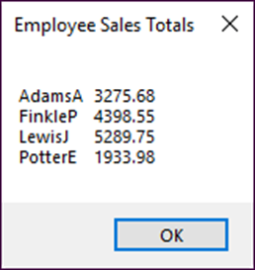
Code that looks up a value in the sorted list based on a key
string employeeKey = "LewisJ";
decimal salesTotal = salesList[employeeKey];
Code that converts the sorted list to a tab-delimited string
string salesTableString = "";
foreach (KeyValuePair<string, decimal> employeeSalesEntry
in salesList)
{
salesTableString += employeeSalesEntry.Key + "\t"
+ employeeSalesEntry.Value + "\n";
}
MessageBox.Show(salesTableString, "Employee Sales Totals");

Slide 62
Properties and methods of the Queue<> class
Property Description
Count Gets the number of items in the queue.
Method Description
Enqueue(object) Adds the specified object to the end of the queue.
Dequeue() Gets the object at the front of the queue and removes it from the queue.
Clear() Removes all items from the queue.
Peek() Retrieves the next item in the queue without deleting it.

Slide 63
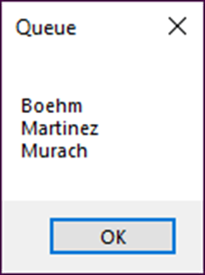
Code that uses a queue
Queue<string> nameQueue = new Queue<string>();
nameQueue.Enqueue("Boehm");
nameQueue.Enqueue("Martinez");
nameQueue.Enqueue("Murach");
string nameQueueString = "";
while (nameQueue.Count > 0)
nameQueueString += nameQueue.Dequeue() + "\n";
MessageBox.Show(nameQueueString, "Queue");

Slide 64
Properties and methods of the Stack<> class
Property Description
Count Gets the number of items in the stack.
Method Description
Push(object) Adds the specified object to the top of the stack.
Pop() Gets the object at the top of the stack and removes it from the stack.
Clear() Removes all items from the stack.
Peek() Retrieves the next item in the stack without deleting it.

Slide 65
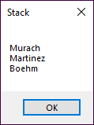
Code that uses a stack
Stack<string> nameStack = new Stack<string>();
nameStack.Push("Boehm");
nameStack.Push("Martinez");
nameStack.Push("Murach");
string nameStackString = "";
while (nameStack.Count > 0)
nameStackString += nameStack.Pop() + "\n";
MessageBox.Show(nameStackString, "Stack");

Slide 66
The syntax for retrieving a value from an array list
(type) arrayName[index]
Code that creates an array list that holds decimal values
decimal[] newSalesTotals =
{3275.68m, 4398.55m, 5289.75m, 1933.98m};
ArrayList salesTotals = new ArrayList();
foreach (decimal d in newSalesTotals)
salesTotals.Add(d);
Another way to create the array list
ArrayList salesTotals = new ArrayList
{ 3275.68m, 4398.55m, 5289.75m, 1933.98m };
Code that retrieves the first value from the array list
decimal sales1 =
(decimal) salesTotals[0]; // sales1 = 3275.68

Slide 67
Code that inserts and removes an element from the array list
salesTotals.Insert(0, 2745.73m);
// insert a new first element
sales1 = (decimal) salesTotals[0];
// sales1 = 2745.73
decimal sales2 = (decimal) salesTotals[1];
// sales2 = 3275.68
salesTotals.RemoveAt(1); // remove the second element
sales2 = (decimal) salesTotals[1];
// sales2 = 4398.55

Slide 68

Code that displays the array list in a message box
string salesTotalsString = "";
foreach (decimal d in salesTotals)
salesTotalsString += d + "\n";
MessageBox.Show(salesTotalsString, "Sales Totals");

Slide 69
Code that checks for an element in the array list and removes it if it exists
decimal x = 2745.73m;
if (salesTotals.Contains(x))
salesTotals.Remove(x);
Code that sorts and searches the array list
salesTotals.Sort();
int sales2Index = salesTotals.BinarySearch(sales2);

Slide 70
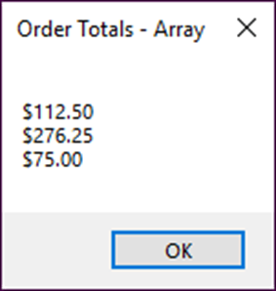
Exercise 8-1 Use an array and a list
Add an array and a list to the Invoice Total application of chapter 7.

Slide 71
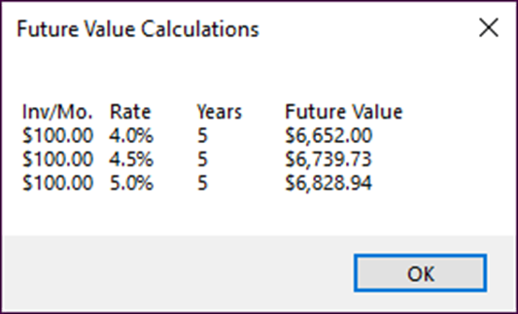
Exercise 8-2 Use a rectangular array
Add a rectangular array to the Future Value application of chapter 7.

Slide 72
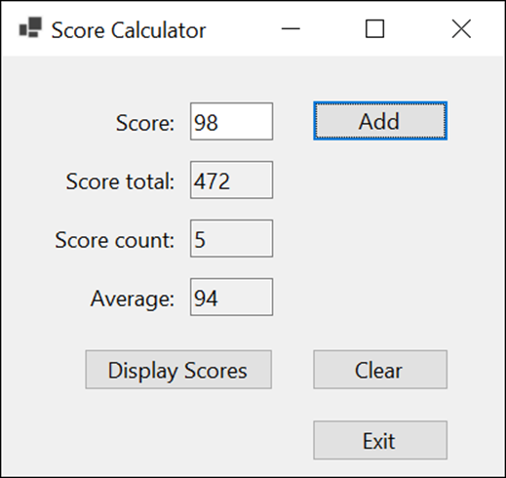
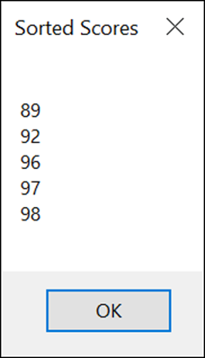
Extra 8-1 Display a test scores array
Enhance the Score Calculator form of extra exercise 4-2 so it saves the scores in an array and lets the user display the sorted scores in a dialog box.

Slide 73
Extra 8-2 Display a test scores list
Modify the Score Calculator form of extra exercise 8-1 so the scores are stored in a list instead of an array.

Slide 74
Objectives (part 1)
Applied
Given the specifications for an application that requires the use of a one-dimensional, rectangular, or jagged array, write the code that works with the array.
Given the specifications for an application that requires the use of one of the collection classes presented in this chapter, write the code that works with the collection.
Knowledge
Distinguish between a for loop and a foreach loop.
Explain how the Array class can be used with an array.
Describe how the null-conditional operator works and when you would use it.

Slide 75
Objectives (part 2)
Distinguish between an untyped and a typed collection class.
Describe the differences between these collection classes: list, sorted list, queue, stack, and array list.

